Slide 1
2013 Grand Slam data
Önder türe

Slide 2

Grand slam data
Data is from UC Irvine Machine Learning Repository.
There is 8 different csv file for 4 different 2013 grand slam group by gender.
All csv file have 42 variable.
For the Project, all csv file combined and created one data with 2 more variables as ’Tournament’ and ‘Gender’

Slide 3
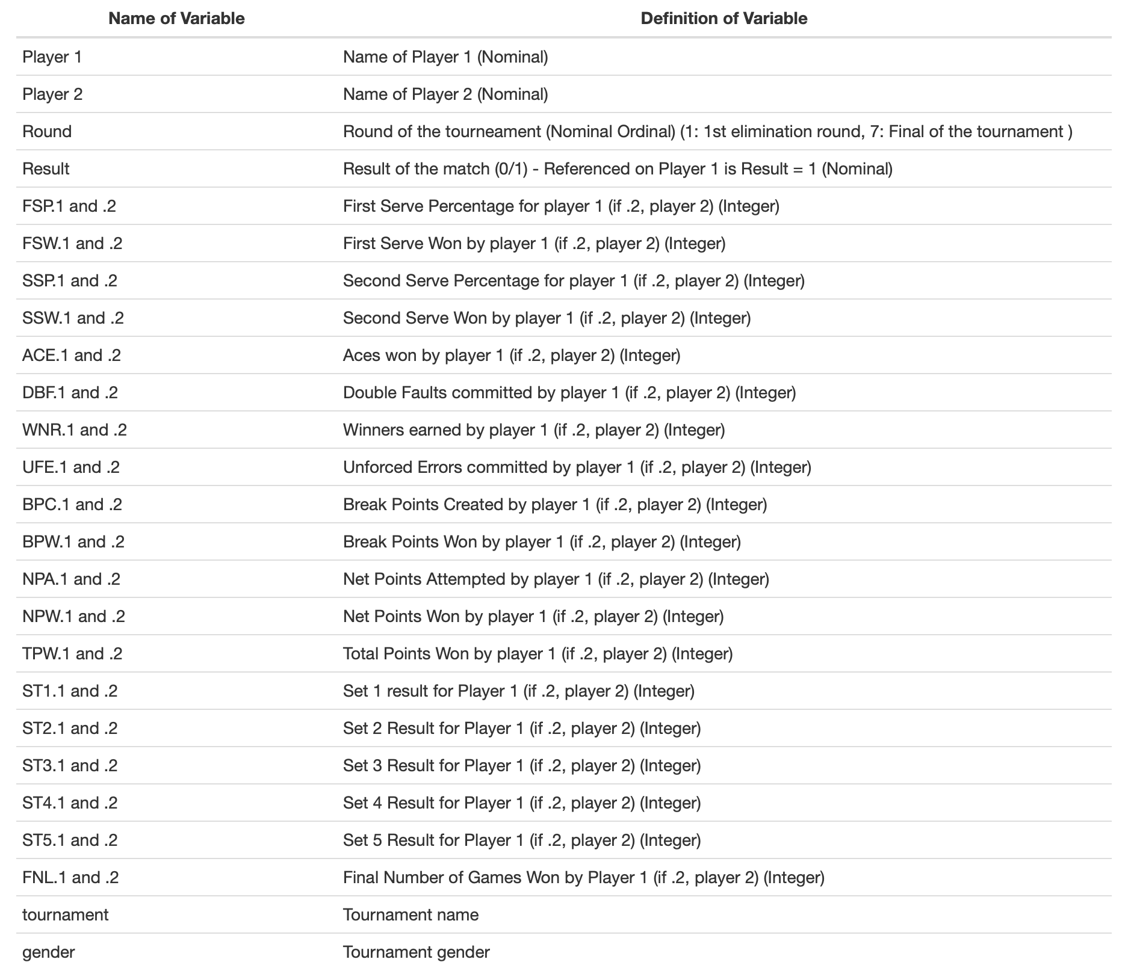
VarIables
There is 44 variables and our dependent variable is ‘Result’
Data formed by 943 rows.

Slide 4

Aım of the project
Aim of the project is predict the result of the tennis match by using different match statistics.
Another aim is to find most effective match statistics for the win and total points win.

Slide 5
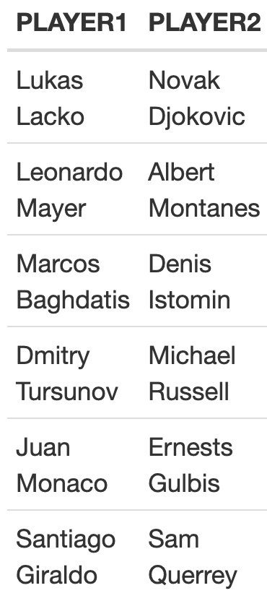
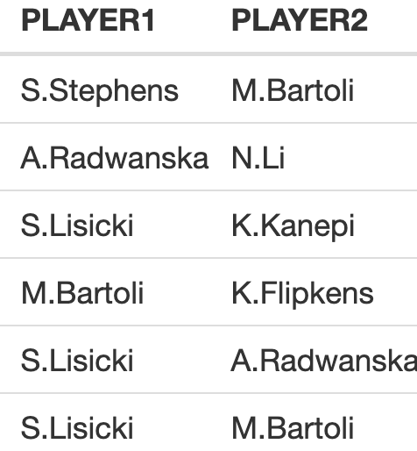
DATA CLEANING And TIDYING
There is a problem about player names column because of writing names with different types like below. All names changed as shorter version like «M.Bartolli
After fixed player names, there is 358 unique player on the data set.
Because of this player names columns are removed from data set.

Slide 6
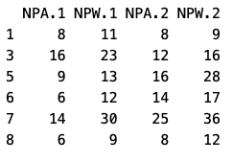
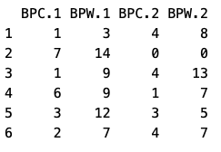
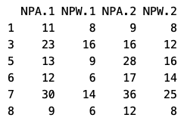
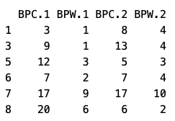
DATA CLEANING And TIDYING
There is problem about BPC(Break Points Created) and BPW(Break Points Win). Logically, BPC must be greater or equal to BPW but in some rows BPC is lower than BPW like below example. This fixed by exchanging BPC values by BPW and BPW values by BPC when BPW > BPC.
NPA and NPW has same issue, and it fixed too.
Fixed

Slide 7
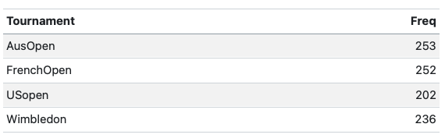
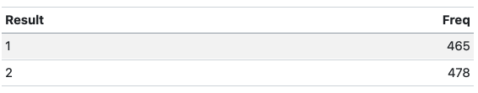
DESCRIPTIVE STATISTICS
There are 4 diffrent tournaments on data set, all of them has similar number of matches.
When we look at the Result distribution. It seem balanced.

Slide 8
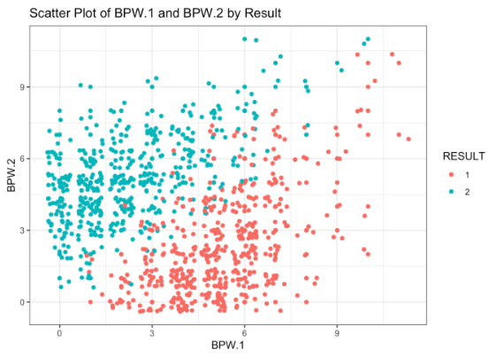
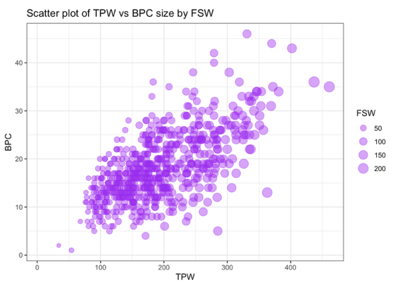
Exploratory Data analysIs

Slide 9
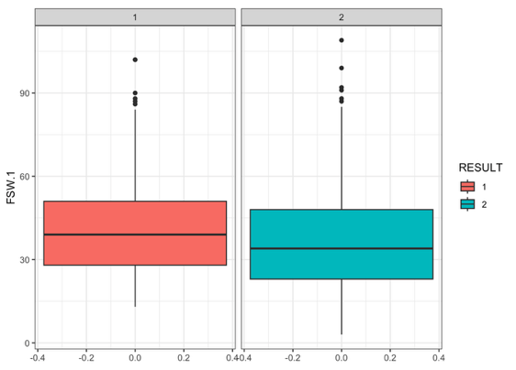
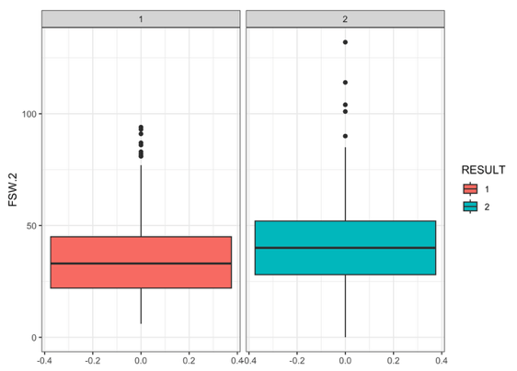
Exploratory Data analysIs

Slide 10
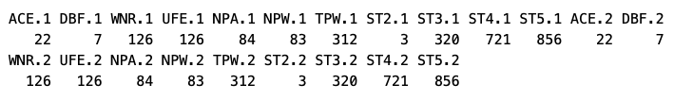
MISSING OBSERVATIONS and DATA MANIPULATION
There are 5338 NA values on dataset.
Firstly FNL.1 and FNL.2 columns are removed from data set, because they are totaly related to result.
ACE, DBF, NPA NA values are imputated by median values.
Rows that has NA UFE and WNR values removed from data set because this variables can be effective to result and removing the column may not be good idea. Also UFE and WNR NA values are from same rows.

Slide 11
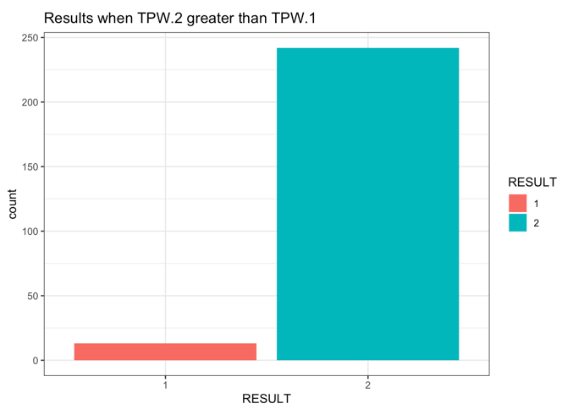
MISSING OBSERVATIONS and DATA MANIPULATION
There are 312 NA values for total points win (TPW) observations. As seen in the bar graph, when player’s TPW is greater than opponent player, this player wins the match, it is almost like result. Therefore TPW is totaly dependent to result.
However, for regression modeling of TPW, alternative data set formed by removig NA TPW rows.

Slide 12
MISSING OBSERVATIONS and DATA MANIPULATION
Set scores (ST) are similar to TPW, if we know 2 players set score, match result can be known. Therefore ST values should be removed from data set.
However, number of total game (TG) variable can be created from sum of all ST values for each row. Number of total game can be use for standardize the match statistics. For example we can find avarage number of ace for 1 game from ACE.1 over TG.
At the end of data cleaning process, 2 data set prepared for classification for result and regression for TPW per game.

Slide 13
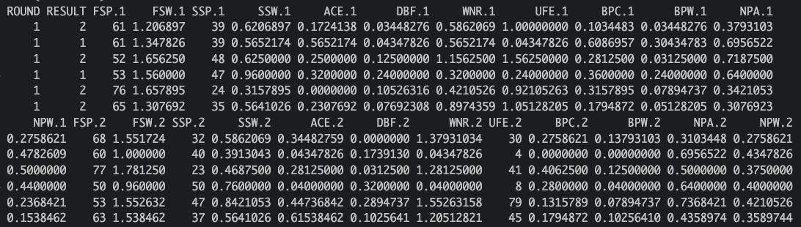
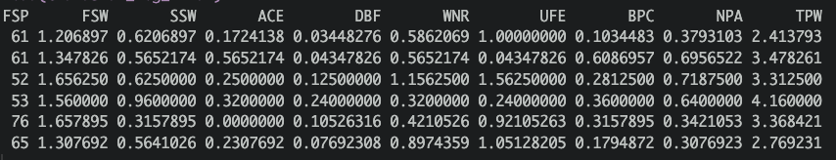
Classification Data
Regression Data

Slide 14
ClassIFICATION
Before modelling, Train and test data created as %80 train and %20 test data by stratification for result.
Test and train sets are scaled after splitting, because, test observations should not be effect anything on the train data set in order to maintain integrity of model evaluation.
10 k-fold cross validation used for all models.
Those models are created ;
Logistic Regression
Support Vector Machine
Random Forest
Artificial Neural Network

Slide 15
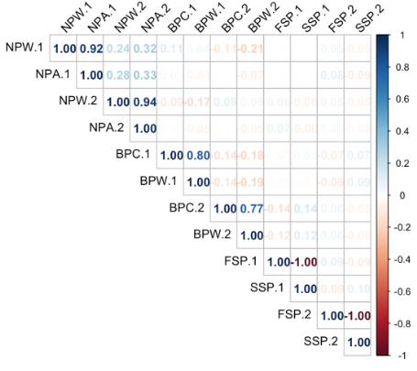
LogISTIC REGRESSION
Before logistic regression, independence of predictors are checked by correlation plot.
There are high correlation between NPW and NPA, BPC and BPW, FSP and SSP. So, NPW, BPW and SSP variables are removed from data set.

Slide 16
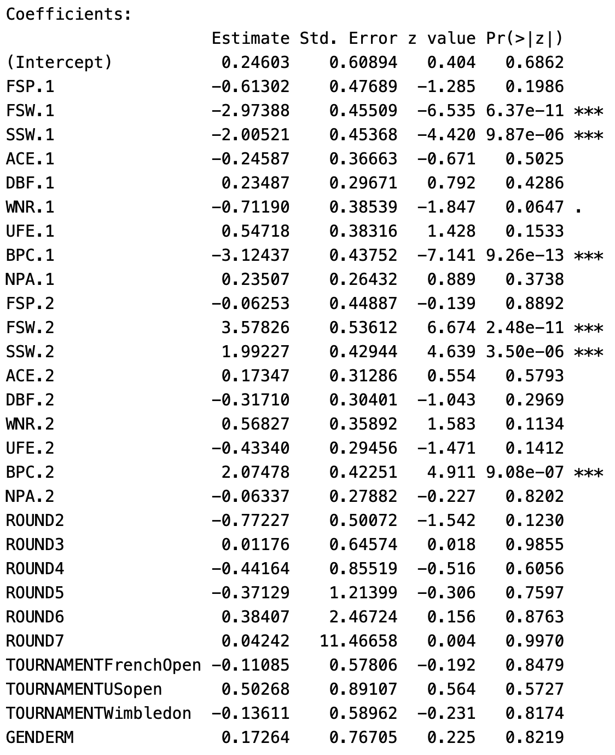
LogISTIC REGRESSION
FSW, SSW and BPC statistics are more effective than other to predict winner. Also, p-values show that FSW, SSW and BPC are highly significant predictors.
WNR and UFE seems marginally significant and can be effective to predict result.
Other predictors are not significant, because of that logistic regression remaked by significant predictors.

Slide 17
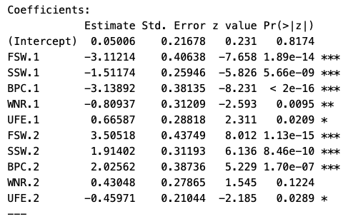
LogISTIC REGRESSION
FSW is the most effective statistics to win the match. When FSW.1 change one unit, the log odds of the outcome decrease 3.11214 units. This means there is negative relationship between probability of result 2 and FSW.1. Similarly SSW.1, BPC.1, WNR.1 and UFE.2 has negative effect to result equal 2.
FSW.2, SSW.2, BPC.2, WNR.2 and UFE.1 has positive relationship.

Slide 18
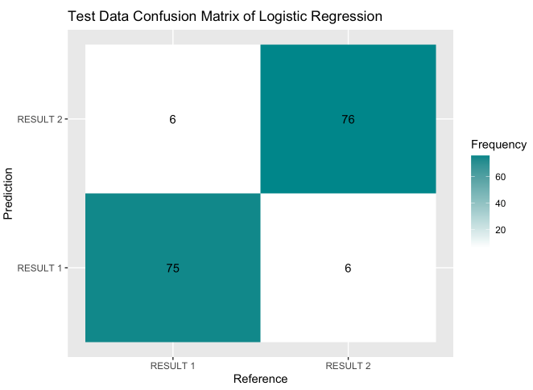
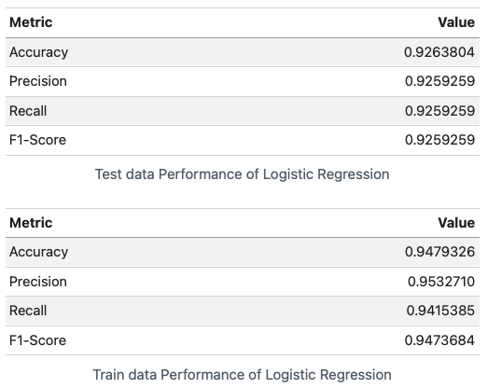
LogISTIC REGRESSION

Slide 19
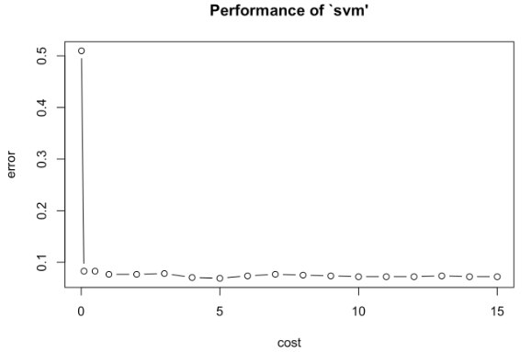
Support VECTOR MACHINE
Linear SVM is used for classification of results.
Cost parameter tuned as 5 after 10 k fold cv by grid search.

Slide 20
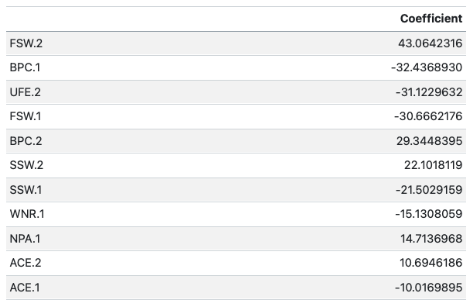
Support VECTOR MACHINE
Linear SVM is used for classification of results.
Cost parameter tuned as 5 after 10 k fold cv by grid search.
First ten absolute coefficient table show that FSW, BPC UFE and SSW are important variables to win the match

Slide 21
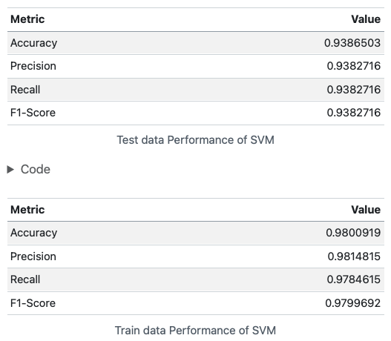
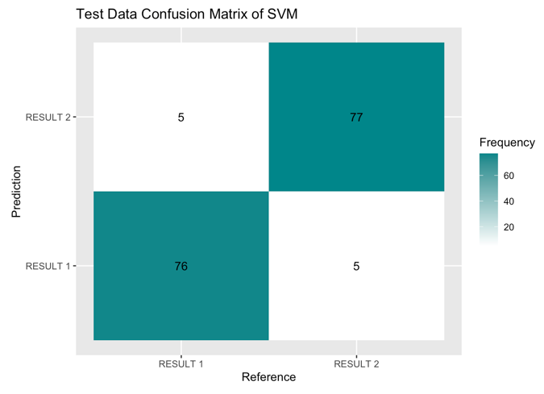
Support VECTOR MACHINE

Slide 22
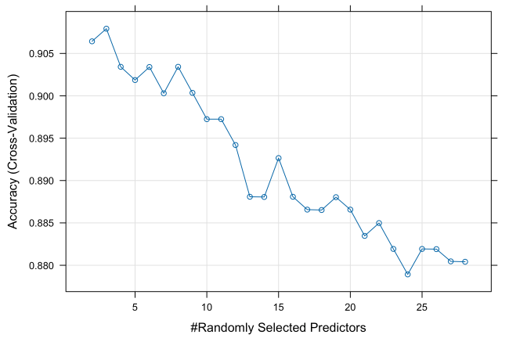
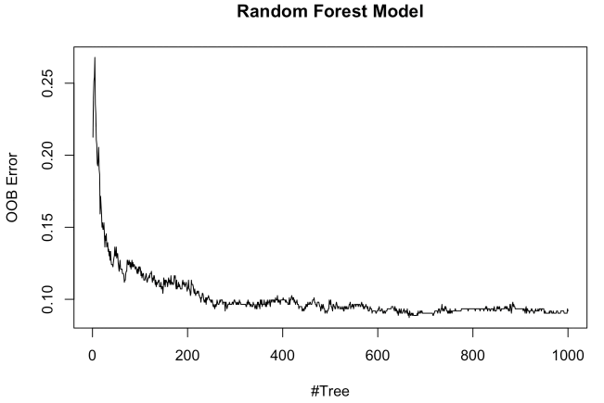
Random FOREST
Random forest model mtry parameter is tuned with 10 k fold cross validation for 2 to 28 grid.
After tuning process, mtry tuned as 3 considering accuracy.
Also, OOB error stabilize after 600-700 trees. Therefore 1000 tree is acceptable for modeling.

Slide 23
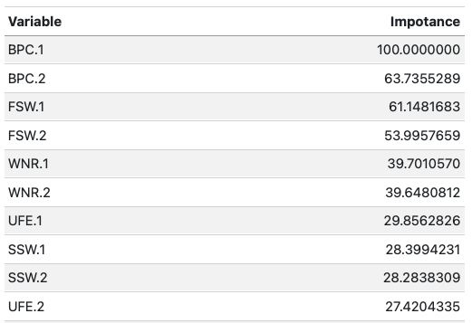
Random FOREST
First ten important variables are given in table. It is created by considering gini index.
BPC, FSW and WNR are the most effective variables.

Slide 24
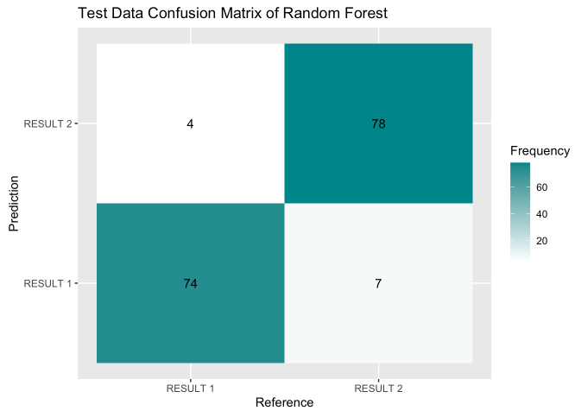
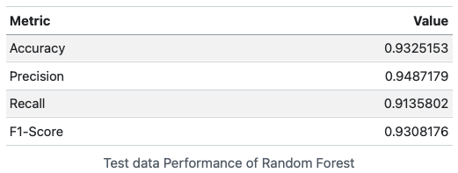
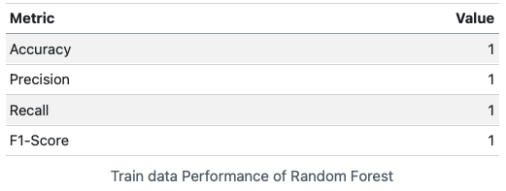
Random FOREST

Slide 25
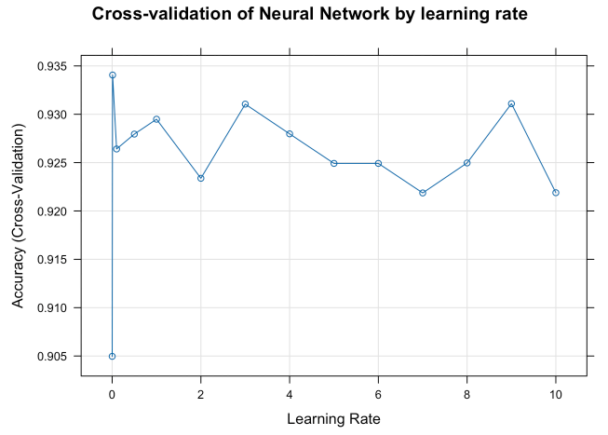
ArtIFICIAL NEURAL NETWORK
Neural network with one hidden layer that has 1 node is used to predict Result.
There is one hidden layer with one node because, we want to make more interpretable model.
Learning rate tuned as 0.01.

Slide 26
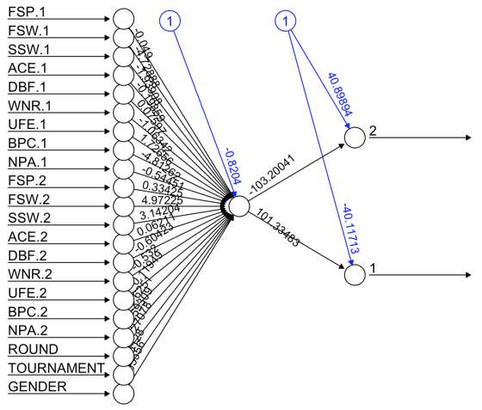
ArtIFICIAL NEURAL NETWORK

Slide 27
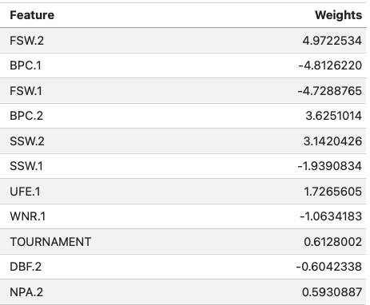
ArtIFICIAL NEURAL NETWORK
Ordered weight table show that FSW, BPC and SSW are important variables to win the match.

Slide 28
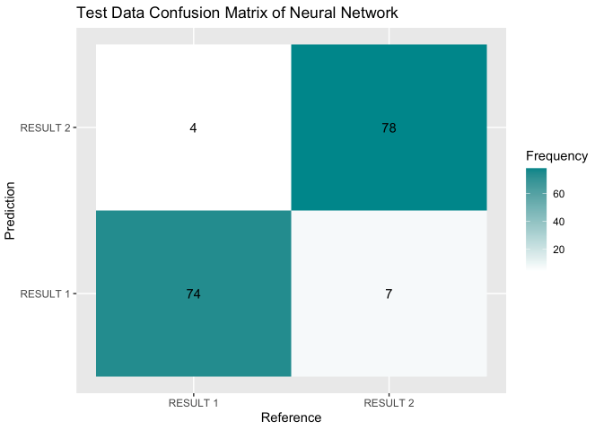
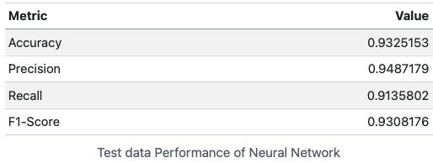
ArtIFICIAL NEURAL NETWORK

Slide 29
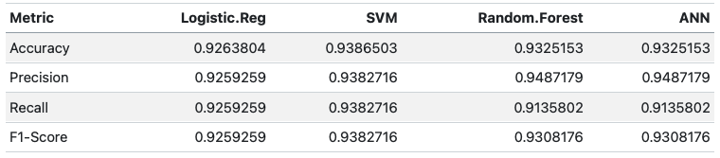
Performance ComparIson
SVM is the best model for predict the result according to accuracy. However, all models working well and close to eachother.
For all models indicate that FSW and BPC are the most important variable. Therefore, Players should practice to shoot well services and try to return oppenent services effectively.

Slide 30
REGRESSION
Regression modeling is applied To predict total points win per game(TPW).
Before modelling, Train and test data created as %80 train and %20 test data by stratification for result.
Test and train sets are scaled after splitting, because, test observations should not be effect anything on the train data set in order to maintain integrity of model evaluation.
10 k-fold cross validation used for all models.
Those models are created ;
Linear Regression
Lasso and Ridge

Slide 31
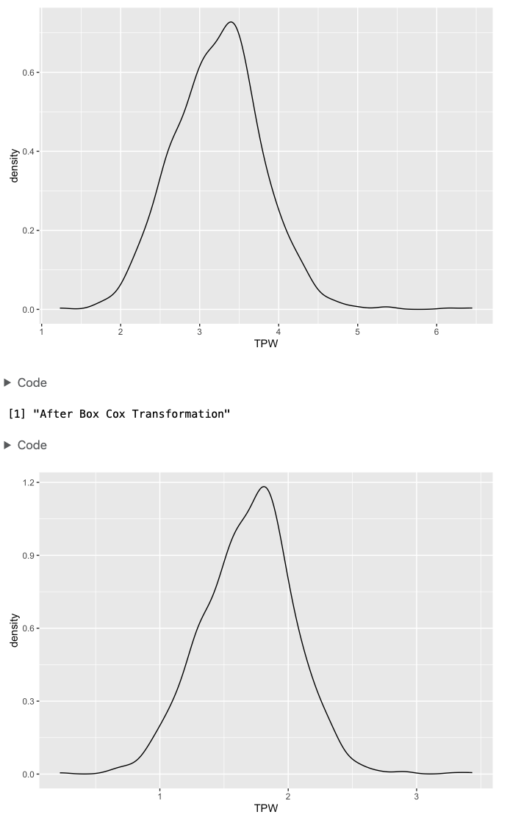
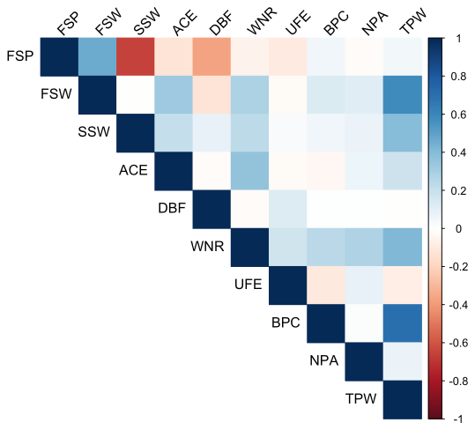
ASSUMPTION CHECK FOR LM
FSP column removed from dataset because of multicollinearity.

Slide 32
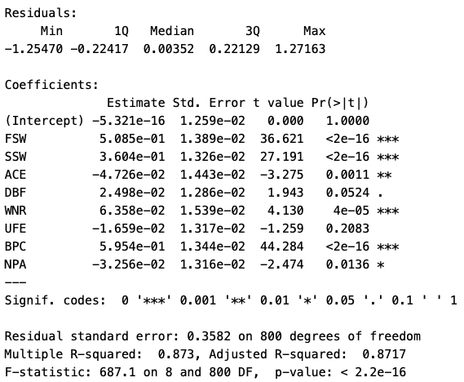
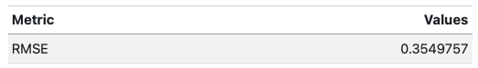
LINEAR REGRESSION
ACE, DBF, UFE, WNR and NPA have small effect on TPW according to parameters.
Also UFE is not significant variable to predict TPW.
FSW, SSW and BPC has significant and positive effect on TPW.

Slide 33
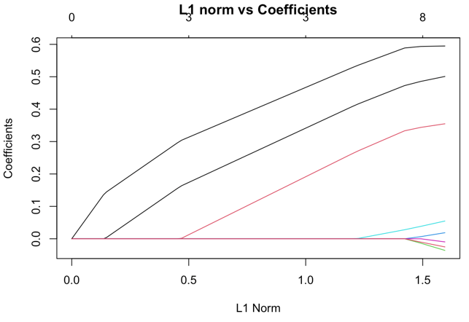
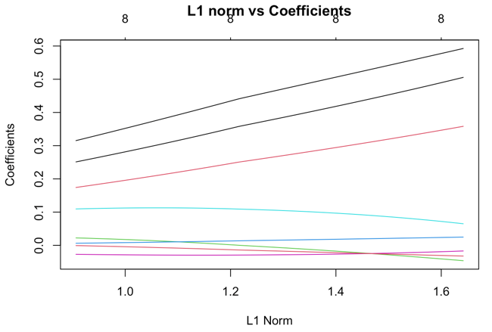
LASSO AND RIDGE REGRESSION
Lasso regression can be used to find most effective variables. Also ridge can help to find most effective variables.
Grid search for lambda shows that FSW, SSW and BPC are the most effective variables to win more points for both of the models.

Slide 34
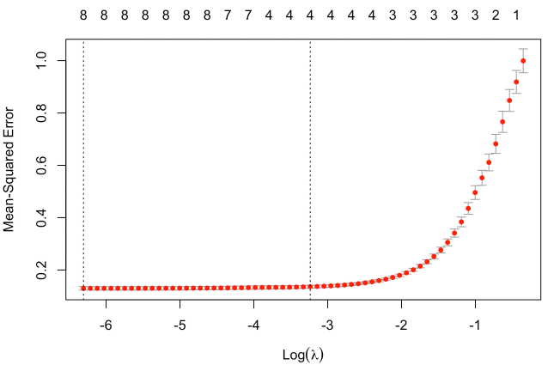
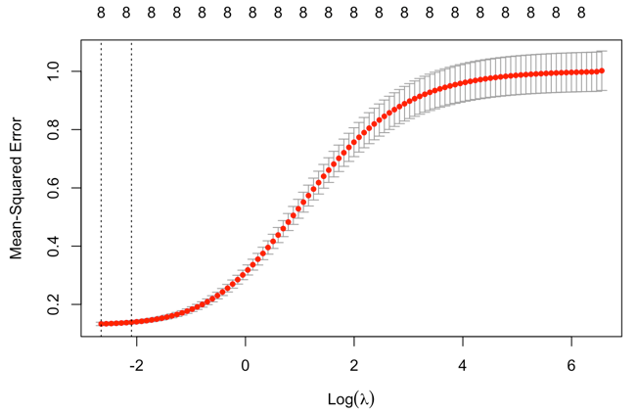
LASSO AND RIDGE REGRESSION
Lasso and Ridge lambda coefficients tuned by cross validation,
Lambda tuned as 0.001824 for lasso.
Lambda tuned as 0.0703011 for ridge.
LASSO
 | Linear Model | LASSO | RIDGE
RMSE | 0.355 | 0.125 | 0.133
RIDGE

Slide 35

Thank YOU

